Slide 1
Why Every Web App Should be a PWA
Carl Bergenhem
jsMobileConf 2019
Wed, 13 Nov | 1:00 PM – 1:45 PM

Slide 2

Who Am I?
Carl Bergenhem
PM, Kendo UI & Web Components
@ Progress
Web developer, fitness enthusiast,
video game aficionado.

@carlbergenhem

Slide 3
Every Web App Should Be a PWA

Change my mind

Slide 4
Agenda
What is a PWA?
Why are PWAs important?
Why Every Web App Should be a PWA
Tools
Q & A

Slide 5
Agenda
What is a PWA?
Why are PWAs important?
Why Every Web App Should be a PWA
Tools
Q & A

Slide 6
Progressive Web Application

Slide 7
What is a PWA?
Web application with native mobile capabilities
HTML, CSS, and JS
Not a hybrid mobile app – true web app
Can be built with any technology
Vanilla, Angular, React, Vue, etc.
Relies on browser support for native functionality
Notes:
Bullets say it all

Slide 8
What is a PWA?




Fast
Integrated
Reliable
Engaging

Notes:
Fast – Respond quickly to user interactions with silky smooth animations and no janky scrolling
Integrated – A look and feel that complies with the native platform – app icons on the home screen, apps that run in full screen, etc.
Reliable – load instantly and never show the downasaur, even in uncertain network conditions
Engaging – Feel like a natural app on the device, with an immersive user experience
https://developers.google.com/web/progressive-web-apps

Slide 9
Agenda
What is a PWA?
Why are PWAs important?
Why Every Web App Should be a PWA
Tools
Q & A

Slide 10
Agenda
What is a PWA?
Why are PWAs important?
Why Every Web App Should be a PWA
Tools
Q & A

Slide 11
Why Are PWAs Important?
80% of users time is spent in 3 apps
13% of mobile users time is in web apps
87% of mobile users time is in native apps
Majority of users: 0 installs / month
Average user: 2 installs / month
Average users visits 100 websites / month
Notes:
These are just some high level stats of PWAs vs. Native apps. While this may not affect your web apps if you’re not targeting mobile, it’s something that is good to consider in general when we start talking about PWAs and their impact.
https://www.comscore.com/layout/set/popup/Request/Presentations/2017/The-2017-US-Mobile-App-Report?logo=0&c=12?utm_campaign=CONFIRMED_OPT_IN_AUTO_RESPONDER_ALL&utm_medium=email&utm_source=comscore_elq_OCT2018_OPTIN_CONFIRMATION_CONTENT_ALL_AR
https://www.youtube.com/watch?time_continue=80&v=1QILz1lAzWY

Slide 12
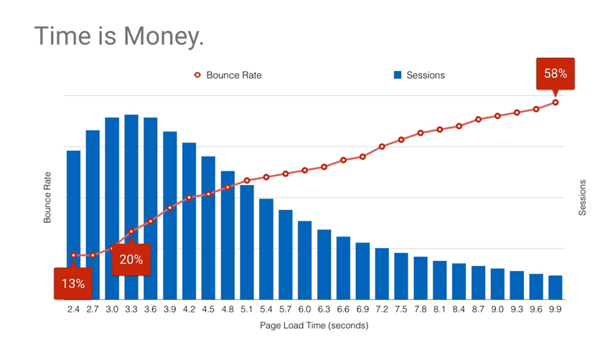
Why Are PWAs Important?
Notes:
Easy to see that with a longer page load you get a higher bounce rate.
With a public website it is very critical to keep bounce rates as low as possible.
For internal applications every second can lead to another “this app is slow” bug being reported by your end users.
https://www.youtube.com/watch?time_continue=80&v=1QILz1lAzWY

Slide 13
Why Are PWAs Important?




Distribution
Reach
Performance
Extending the Web
Notes:
Distribution – the problem with ANY native app is distribution. Make the application available for all platforms. Making people install your app if its there.
Reach – You are siloed with native apps (Windows/macOS/Linux & iOS / Android), but the web can be reached by all
Performance – Without a focus on performance (load times, interaction times, etc.) you cannot be considered a PWA. This is something that ALL web applications can learn from
Extending the web platform – wonderful side effect that web developers get more and more functionality
- Reach - 1B monthly mobile Chrome users (just 400M a few years ago)
- 3.3 Monthly Unique visitors (app) vs 8.9 on web
- Can probably see this difference in your analytics
- 50%-90% of site traffic is mobile traffic
- Mobile web has low engagement. 201.8 average minutes per visitor (app) vs. 10.9 (web)
- Acquisition cost 4.00 euro (app) vs 0.35 euro (web)

Slide 14

Why Are PWAs Important?
Starbucks
Used PWA to target emerging markets
Final app is 233 KB
99.84% smaller than native iOS (148 MB)
2x daily and monthly active users on website
20% increase in mobile conversion
Notes:
https://formidable.com/work/starbucks-progressive-web-app/
https://www.youtube.com/watch?time_continue=5160&v=GAkkKjds00o
-> Used PWAs to target emerging markets & rural communities (2G connection)
-> PWA
-> Built from the ground-up but replicating the native mobile app
-> Final app was 233KB, 99.84% smaller than the 148MB size of the native iOS app
-> 2x daily and monthly active users on their website
-> Desktop app is about the same
-> 20% of mobile conversion app after switching to a PWA

Slide 15
Why Are PWAs Important?
Other Examples
Twitter Lite – App is just 420KB (3% of native app)
Uber – PWA is just 50 KB
Tinder – Load times reduced from 11.9s to 4.69s
West Elm – 15% increase in time spent 9% increase in revenue
Notes:
https://www.pwastats.com

Slide 16
Agenda
What is a PWA?
Why are PWAs important?
Why Every Web App Should be a PWA
Tools
Q & A

Slide 17
Agenda
What is a PWA?
Why are PWAs important?
Why Every Web App Should be a PWA
Tools
Q & A

Slide 18
Why Every Web App Should be a PWA
Even if you can’t make it a true PWA
Notes:
I’m not saying you should re-write every app to be a PWA
Nor should you re-build your apps as PWAs
These are aspects of PWAs that can impact any web app, regardless of internal, external, desktop, or mobile-focused

Slide 19
Responsive Design

Slide 20
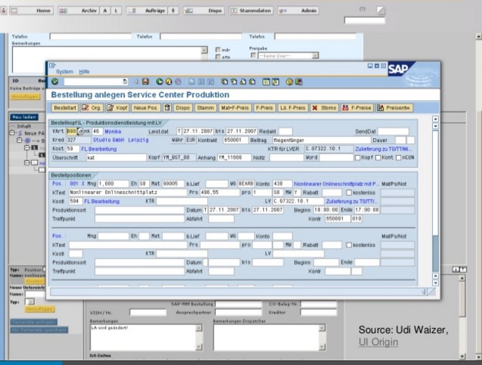
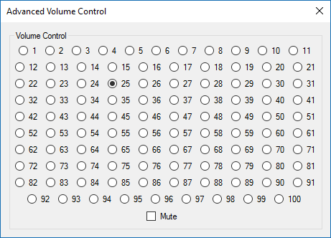
“Enterprise” Apps
Notes:
We don’t always think about responsive design even for internal applications because we may be creating applications like these. Either replicating desktop apps in the web, or creating a radio button list for volume control of 0-100.

Slide 21
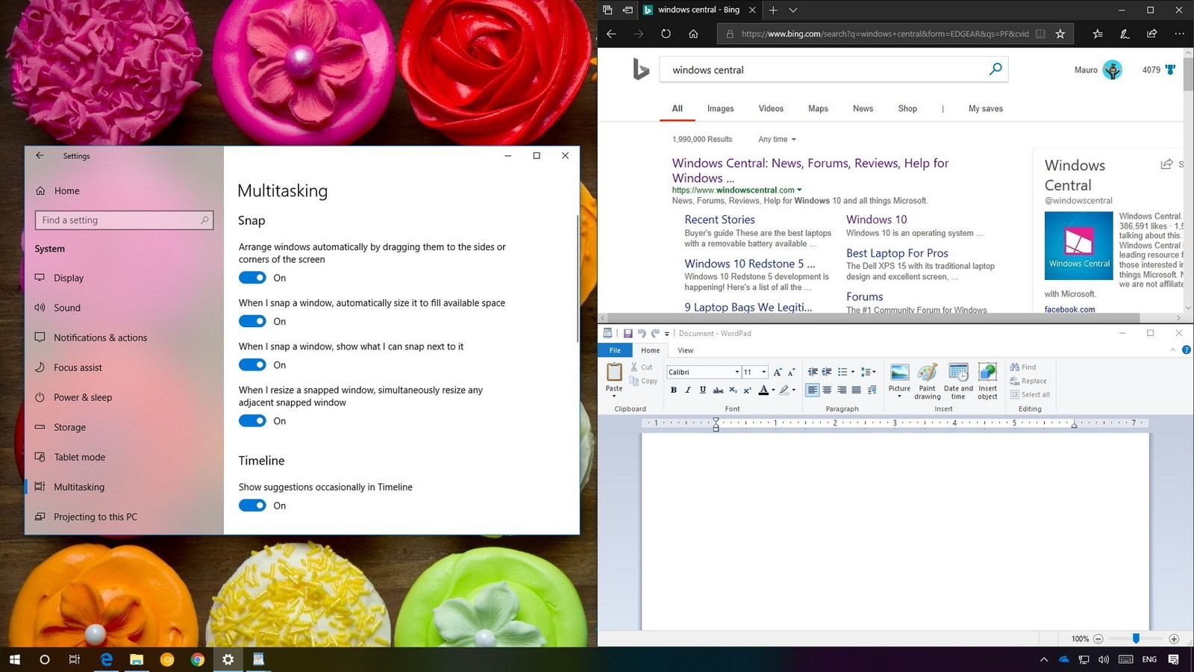
Responsive Design
Responsive design isn’t just for mobile
High-density vs regular monitors
Full screen is not always available
We cannot assume the preferred size of the app
A pixel is not a pixel
Notes:
As we can see in the image here, this particular interface has one half of the screen taken up by an un-docked window while the right-hand side has two apps open and dividing the screen further, essentially taking up quarters. Can your existing app handle this?
Image credit: https://www.windowscentral.com/how-use-snap-assist-windows-10-0

Slide 22
Responsive Design
Ideally - build for smallest screen size
Focus on content first
Manipulate content based on available real estate
Reorder, reposition, replace, and even delete content
Ideally – deep understanding of users
Customer interviews are key
Notes:
Coming from a PM perspective: customer insight is key. We often times forget this for our internal “customers” and need to

Slide 23
Responsive Design
Just use Bootstrap

CSS Grid
Flexbox
Notes:
The easiest thing to do is just use Bootstrap. However, this may even be overkill. CSS Grid and Flexbox may seem intimidating at first but are very easy to pick up and can be used for most designs that we are dealing with today.

Slide 24
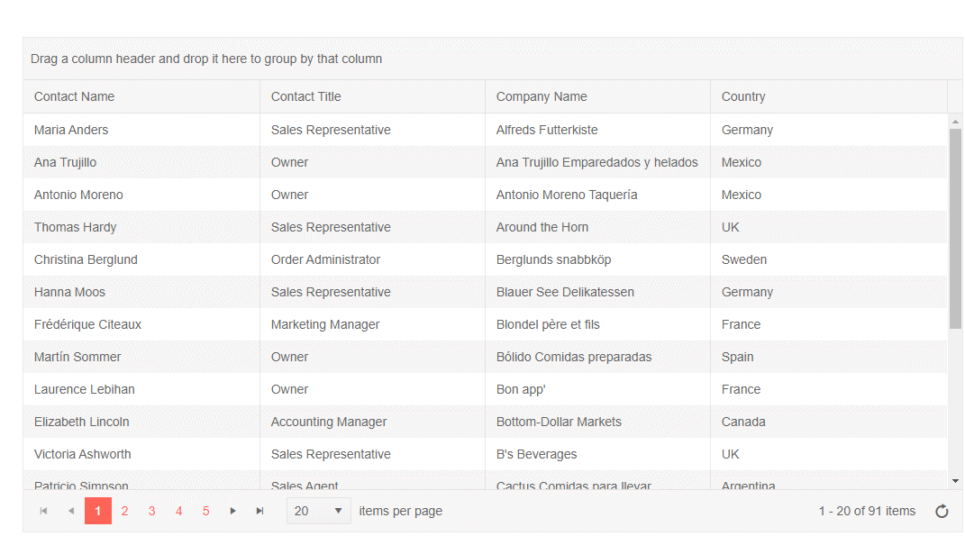
Responsive Design
UI Components
Make sure any UI elements are responsive
Easy mode: width: 100%
Hard mode: complex UI
Determine what to show and hide within components
Notes:
If you build your own components make sure that they can handle responsive scenarios. Whether it is a width of 100% or something more complex in terms of UI that requires you to take more responsibility for the responsive behavior.
The gif shows off a Kendo UI grid and you can see how the pager changes, we remove some columns, and fit in to a smaller screen.

Slide 25
Responsive Images

Slide 26
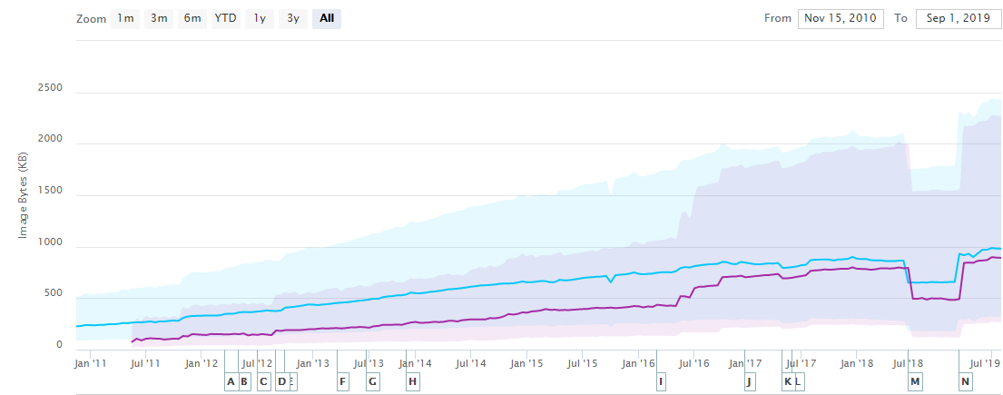
Responsive Images
Images consume the most bytes on pages
51% of transferred bytes on page load are images
~20% of a website is just images
Image bloat on median websites is actually increasing!
Notes:
https://medium.com/@firt/faster-paint-metrics-with-responsive-image-optimization-cdns-d43340d4a48c - 51% of transferred bytes
https://httparchive.org/reports/page-weight#bytesImg – 20% of website bytes

Slide 27
Responsive Images
Image Type
Decide on the right image type: WebP, PNG, or JPEG
Ensure compression no matter the format
Trade-off between compression and quality
Consider WebP if possible:
WebP can decrease file size by 85% compared to JPEG
WebP can decrease file size by 11% compared to PNG
GIF should always use video (.mp4) where possible
Notes:
WebP vs JPEG -> https://www.keycdn.com/support/jpg-to-webp
WebP vs PNG -> https://www.keycdn.com/support/png-to-webp

Slide 28
Responsive Images

images
Don’t use images

Slide 29
Responsive Images
Use vector formats like Icon Fonts or SVG
Most of our images can be replaced by Icon Fonts or SVG
Logos and icons are most often images today
Image editors can export images to SVG
<img> tags can replace `src` with “logo.svg”
Only use actual images when it is absolutely needed

Slide 30
Responsive Images
Vector Formats
Font Icons
SVG Icons
Included like a font
Smaller file size*
Can be cached
Can lead to multiple request
Can lead to text flashes
Written in a XML format*
Each individual bit can be colored, animated, or manipulated
Naturally responsive
Accessibility
Inline and External SVG
Notes:
SVG are more accessible thanks to having built-in semantic elements (<title>, <desc> etc.)
Inline SVG is not Cached

Slide 31
Responsive Images
Image Tags
Many pages load a single image and resize with CSS
Ensure any images are responsive
Create images for various sizes on the server
Single HTML elements can be used
Any existing <img> element can be updated
Consider the <picture> element

Slide 32
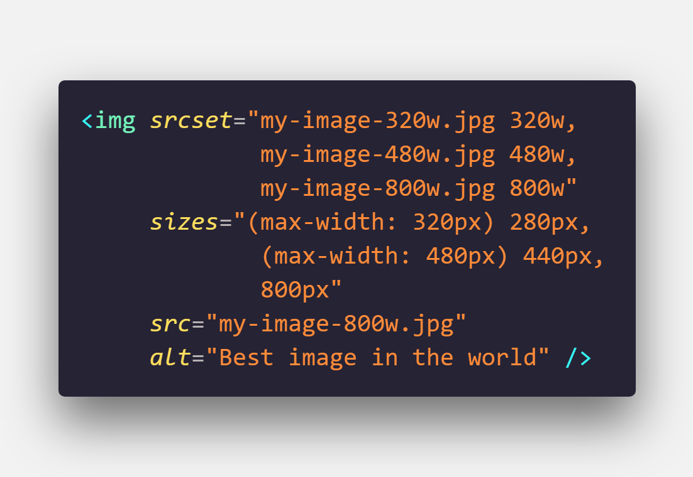
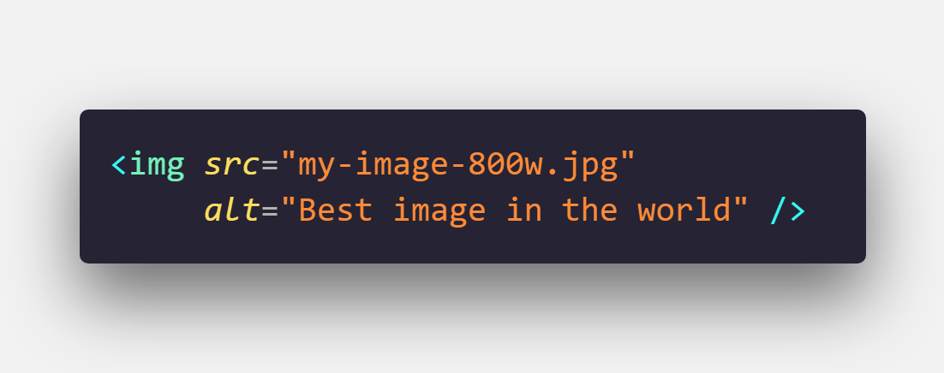
Responsive Images
<img>
Notes:
Format is [image name] – space – inherit width in pixels
Note the “w” unit here. This is the actual image width in pixels, found by inspecting the image in your file system
Sizes defines a set of media conditions (e.g. screen widths) and indicates what image would be the best to use
https://developer.mozilla.org/en-US/docs/Learn/HTML/Multimedia_and_embedding/Responsive_images

Slide 33
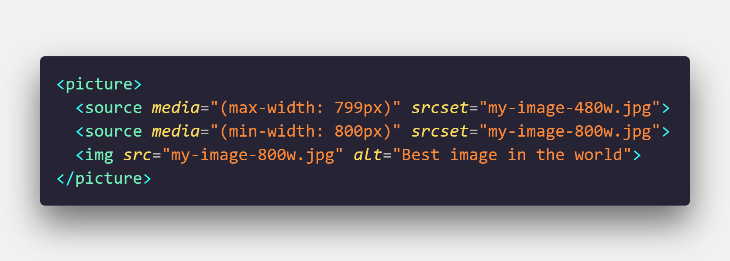
Responsive Images
<picture>
Notes:
Each image we want to offer is written in a <source> tag
Each source element has a media attribute which provides the media condition for displaying the image (media queries)
srcset could take multiple images if we’d like to, letting us provide multiple sizes for the same image (probably wouldn’t need to)
<img> provides us with a default case just in case the source media conditions do not apply, or the <picture> element is not supported

Slide 34
Responsive Images
Element Comparison
<img srcset=“”>
<picture>
Define various image resources
Provide “hints” to the browser
The browser decides which is best to use
Good to use if the same picture will be used everywhere
Define various image resource
Forces the browser to use your sizes
Best when images need to change based on real estate
Solves the “art direction problem”
Notes:
http://usecases.responsiveimages.org/

Slide 35
Performance
Specifically, JavaScript

Slide 36
Performance
JavaScript is the most expensive part of your site
Notes:
-> The median web page ships with over 350KB of minified and compressed JS
-> This is over 1 MB of script
-> We are also lazy and forget to optimize
-> We rely too much on our frameworks. Angular, React, Preact, Vue, and any others are great, but out of the box can be too much.
-> All framework implementations can be optimized, but do we do it?

Slide 37
Performance
First Paint
First Contentful Paint
First Meaningful Paint
First CPU idle
Time to Interactive
Speed Index
Notes:
-> Is it happening? -> First Paint & FCP and
-> Is it useful? -> FMP
-> Is it useable? -> TTI
-> These are all milestone timings
-> There’s also quantity-based metrics (pure file sizes, number of requests, etc.)
https://medium.com/@addyosmani/start-performance-budgeting-dabde04cf6a3

Slide 38
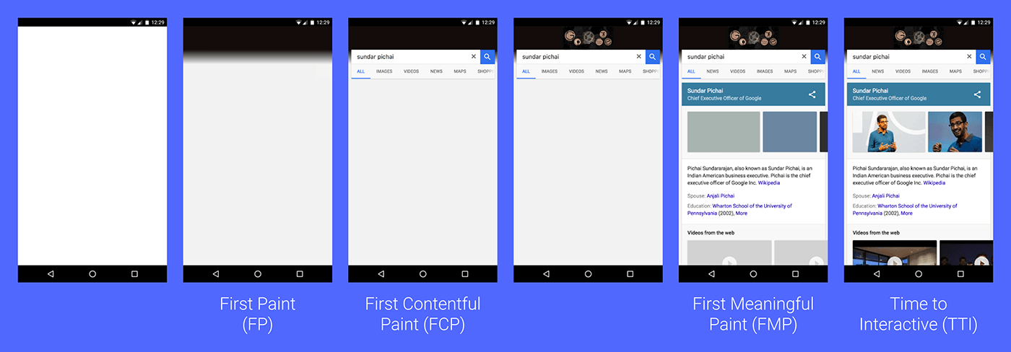
Performance
Notes:
https://developers.google.com/web/fundamentals/performance/user-centric-performance-metrics

Slide 39
No Silver Bullet
Sorry folks

Slide 40
Performance
Approaches
Responsive design & responsive images
Remove superfluous dependencies
Avoid one large single bundle
Prefetching
Loading Images
Virtualization of UI
Notes:
https://medium.com/dev-channel/a-pinterest-progressive-web-app-performance-case-study-3bd6ed2e6154
https://v8.dev/blog/cost-of-javascript-2019

Slide 41
Performance
Bundle Size
Break up your single bundle in to smaller bundles
Rule of thumb, if it is larger than 50-100 KB – split it up
Load only the code that user needs
Lazy-load everything else
Code-splitting is key

Slide 42
Performance
Route-level Code Splitting
about.js
www.myapp.com/about
about
contact-us
app.js
app
contact-us.js
www.myapp.com/contact
Notes:
React
React Router & React Loadable
There are a few other libraries out there to help as well
Angular
Setting loadChildren (instead of component) in the Angular router (route)
This is a module instead of a component
This is a promise() and when resolved will return the component
There’s also a component-level splitting
Vue
Vue-router has built-in support for async components, automatically works with webpacks code-splitting features under the hood

Slide 43
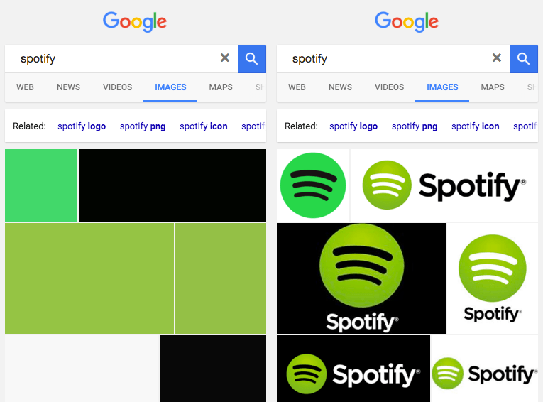
Performance
Loading Images
Don’t immediately load images
Create placeholder div
Load image(s) as they are available
Used by Google Image search
Next level: Medium images
Notes:
-> https://jmperezperez.com/medium-image-progressive-loading-placeholder/
Load a placeholder div and THEN load the image
Next step is something like Medium where you can blur an image before actually loading it

Slide 44

Performance
Loading Images
Traditional images are encoded and decoded top to bottom
Slow loading JPEGs load in this manner

Slide 45

Performance
Loading Images
Progressive JPEGs divide images in to several scans
Loads from blurry and low-quality to high-quality
Gives user a perceived performance boost
These type of images can save 2-10% bandwidth
Notes:
Progressing loading of Images (progressive JPEGS)
-> https://images.guide/#jpeg-compression-modes
https://medium.com/dev-channel/a-pinterest-progressive-web-app-performance-case-study-3bd6ed2e6154
A strategy to load

Slide 46
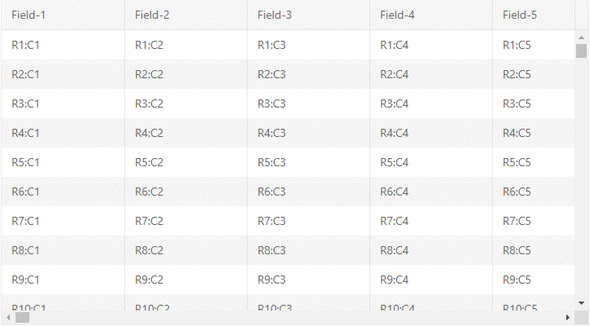
Performance
Virtualization of UI
Is your UI ready to help?
Handle large sets of data
Paging through data
Virtualization of elements
Lazy-loading | Load-on-demand

Slide 47
Performance
Summary
JavaScript is the most expensive part of your web apps
Reduce your bundle size by utilizing code splitting
`prefetch` and `preload` resources
Some performance gains can just be perceived and not benchmarked
Take use of paging, load-on-demand or virtualization in your UI
Notes:
“Most Expensive” means both file size AND execution time

Slide 48
Other PWA Concepts
Entering Full PWA Territory

Slide 49
Other PWA Concepts
Security
Caching strategies
Service workers
Desktop PWA apps
App Store availability
Accessibility*

Slide 50
Tools

Slide 51
Tools
Browser developer tools
Lighthouse
Webpack bundle analyzer
Performance Budget Calculator
Notes:
https://developers.google.com/web/tools/lighthouse
https://github.com/webpack-contrib/webpack-bundle-analyzer
https://www.pwabuilder.com/ https://www.performancebudget.io/

Slide 52
Why Every Web App Should be a PWA
Even if you can’t make it a true PWA

Slide 53
Every Web App Should Be a PWA
PWA concepts can be applied to any web application
Responsive design is not just for mobile apps
Responsive images can have a huge impact
Update your approach to loading images
Avoid one large JS bundle – commit to code splitting
Use prefetch and preload where possible
Some performance tweaks are perceived, not actual

Slide 54
Thanks!
Carl Bergenhem
@carlbergenhem

